Slide 1
FuelMart & Subway Safety Committee Meeting
Wednesday, November 20, 2019
2:00 PM Eastern
Corporate Office Conference Room and GoTo Meeting Web Conference

Slide 2
October 2019 Review:
Safety Topic – Fire Prevention/Fire Safety - Activity
No open safety concerns or suggestions for improvements

Slide 3
Incidents and Injuries From 10/14/2019 to 11/29/2019

Slide 4
Previous Injury – 08/31/2019 –Employee was changing outside garbage. After pulling the bag out of the trash can the employee lost balance and fell. Injury resulted in days away from work. OSHA recordable injury.
11/17/19 Subway employee carrying a box of cookies tripped over a banana pepper box which was not put away during/immediately after the delivery. Injury resulted in days away from work. OSHA recordable injury.
Preventable by keeping walking areas clear and proper storage of products (housekeeping).
Employee Injuries:

Slide 5
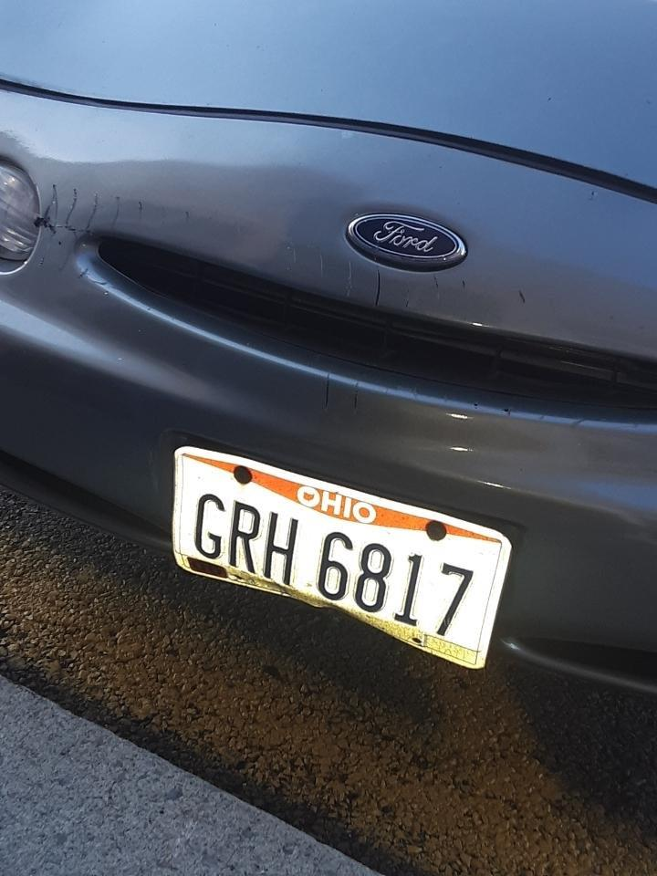
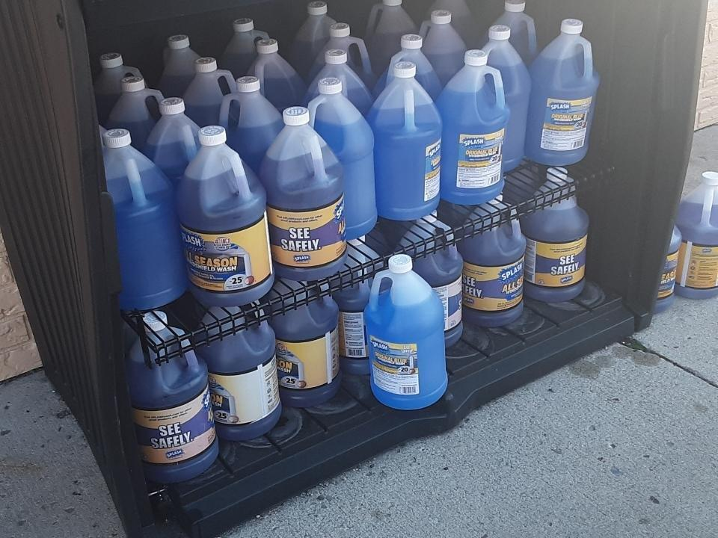
FM 782 property damage:
On 10/28/2019 a customer drove into and damaged the outside plastic cabinet (screws broke) which holds the windshield washer fluid. Will need repaired or replaced. Customer vehicle sustained scratches to the front bumper.

Slide 6
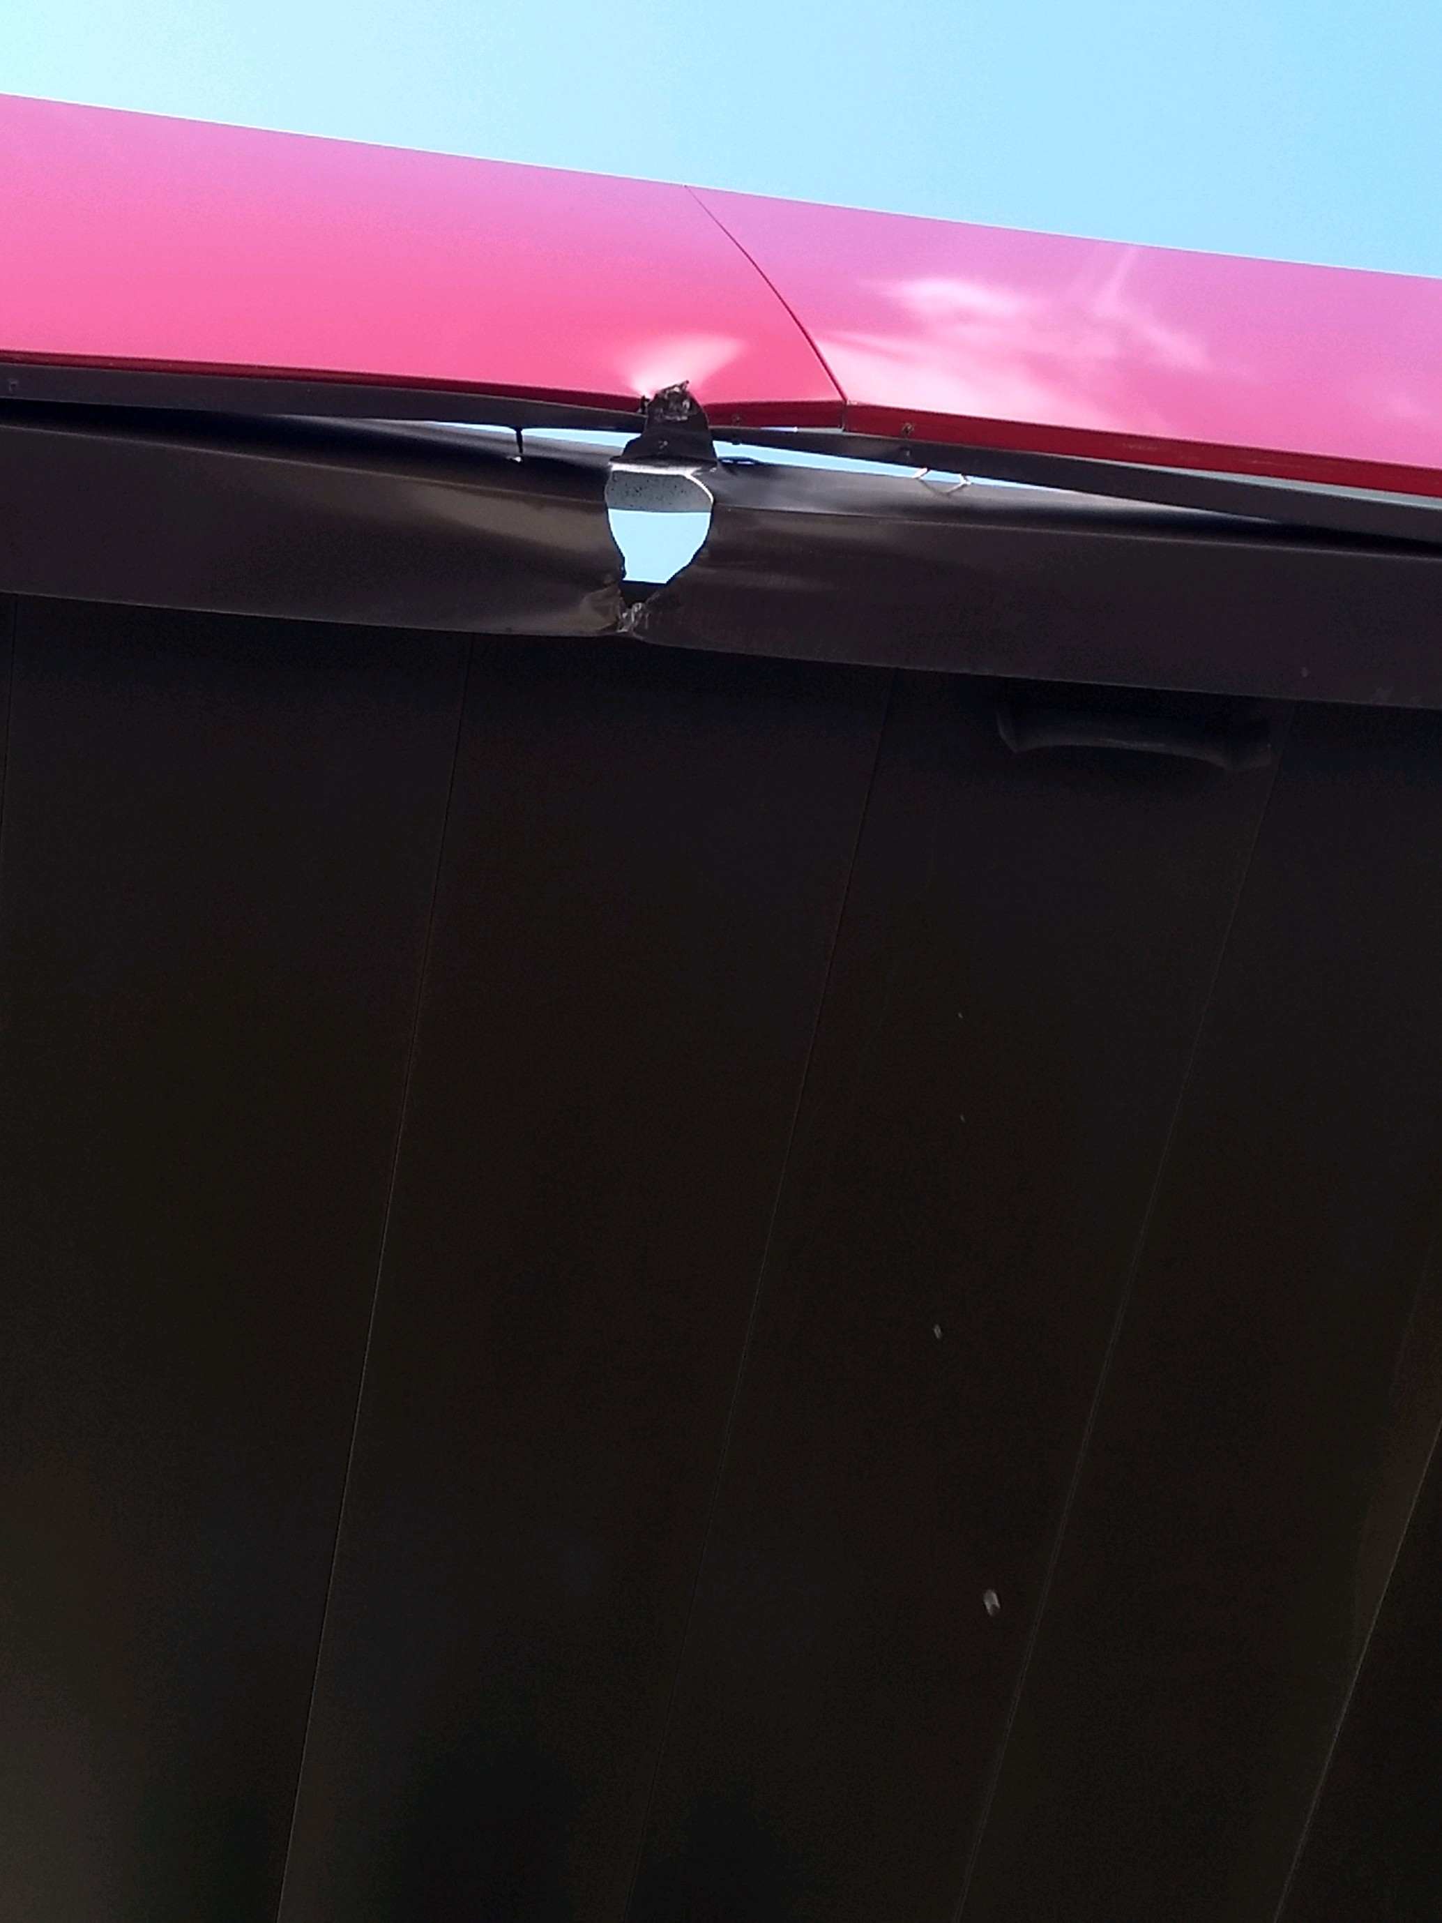
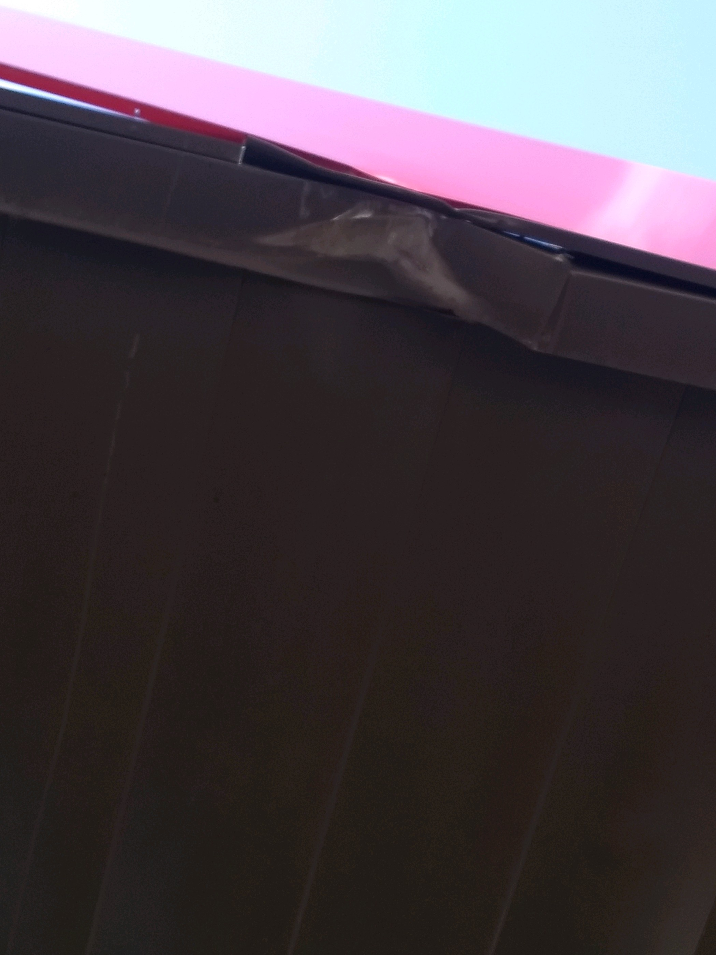
FM 727 property damage:
On 11/08/2019 Les identified damage to the diesel canopy on the last diesel lane. Customer did not report the damage. A couple panels were damaged.

Slide 7
Date Range: Jan. 01, 2019 – Nov. 19, 2019 Company Total Incidents: 165 FuelMart & Subway Total Incidents: 76 (Previously 73) FuelMart & Subway employee injuries Reported: 14 FuelMart Property Damage and/or Vehicle Incidents: 24 FuelMart Customer Spills: 14 (10 spills at fuel pumps) FuelMart & Subway Customer injuries reported: 18 Other Incidents: 6

Slide 8
Safety Topic – Housekeeping

Slide 10
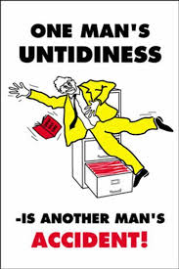
Good housekeeping is a necessary requirement for maintaining safety in the workplace. Clean and tidy worksites hold fewer hazards for all employees as well as customers. Incidents and injuries are avoided, and productivity improved where good housekeeping is a daily occurrence.

Slide 11
Good housekeeping is possibly the most visible evidence of management and employee concern for safety and health that an organization displays on a day-to-day basis. Orderliness at our worksite contributes to a safe environment for our customers by minimizing obstacles and potential safety and health threats, such as spills, trip hazards, etc. In fact, we have several good reasons for housekeeping: Prevents incidents, Prevents fire, Saves time, Gives control to our employees, Increases production, Gives our employees the freedom to move, Gives our employees pride, Protects our products and equipment and Reduces our waste.

Slide 12
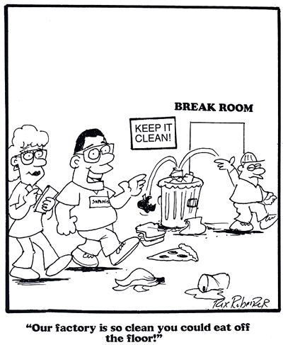
As a manager take a walk around of your facility to Identify main housekeeping issues, such as a lack of order, spills, icy patches, blocked or unsafe exit routes, sharp or protruding objects, overgrown weeds, or other hazards due to poor organization, poor maintenance, or poor housekeeping;
Check that proper clearances are provided around storage, lighting, heating units, electrical panels, sprinklers, and fire extinguishers;
Ensure that noncompatible chemicals are segregated from each other;
and
Ask employees working in each area to identify and recommend any corrective actions for their area.

Slide 13
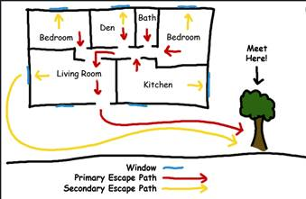
Making Safety A Family Affair
Share a photo that depicts you and your family conducted a home fire drill at your outside meeting location with a sign promoting fire safety at home, fire prevention month, house evacuation map, etc.

Slide 14
Making Safety A Family Affair
Helen Evans
Cody Secrest
500 points will be added to your card.

Slide 15
Submitted by Helen Evans 783

Slide 16
Submitted by Cody secrest 783

Slide 17
Employee Concerns:
One of our FuelMart managers shared that employees did not want to participate in our family fire drill activity because they didn’t want to take a selfie.
We want to hear from you. Any questions, ideas or concerns are welcome! This was meant to be a learning opportunity for your family. We love fun interesting ideas!

Slide 18
Open Floor Safety Questions / Concerns
Next Safety Committee Meeting is Wednesday, Dec. 18, 2019 at 2:00 PM Eastern

